Slide 1
2D Performance Plots
G. Watts (UW/Seattle)

Slide 2
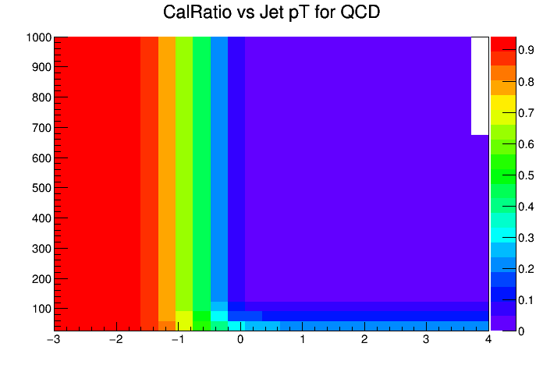
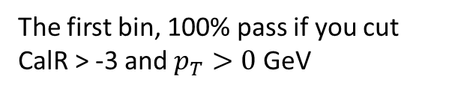
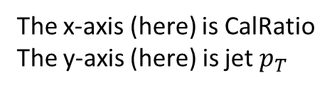
The Plots
The x-axis (here) is CalRatio
The y-axis (here) is jet $p_{T}$
Each bin is the fraction of events if you cut greater than.
The first bin, 100% pass if you cut CalR > -3 and $p_{T}>0$ GeV
This is QCD, just J2
The key is to compare samples and background

Slide 3
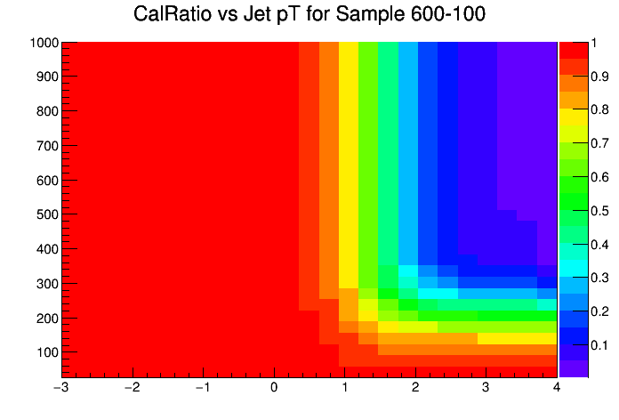
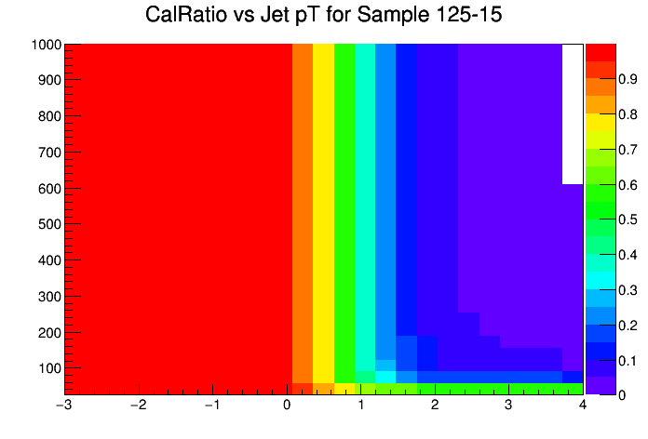
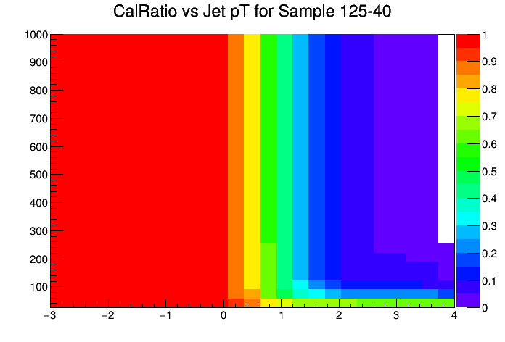

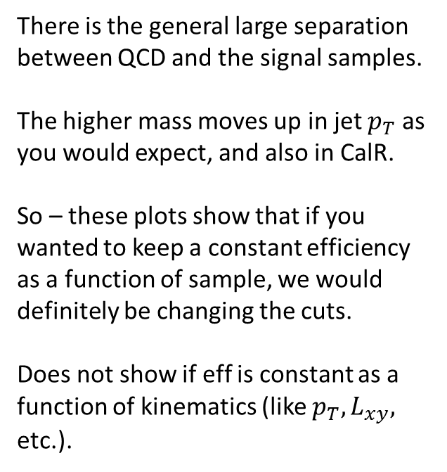
CalR vs Jet $p_{T}$
There is the general large separation between QCD and the signal samples.
The higher mass moves up in jet $p_{T}$ as you would expect, and also in CalR.
So – these plots show that if you wanted to keep a constant efficiency as a function of sample, we would definitely be changing the cuts.
Does not show if eff is constant as a function of kinematics (like $p_{T}, L_{xy},$ etc.).

Slide 4
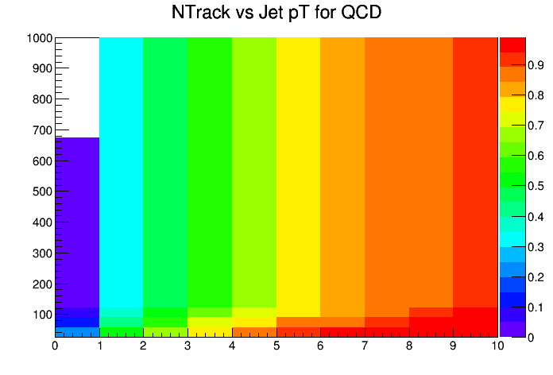
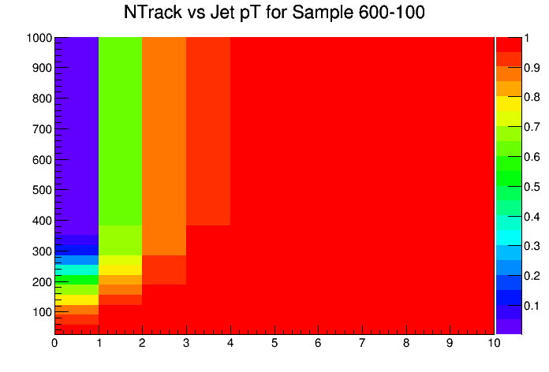
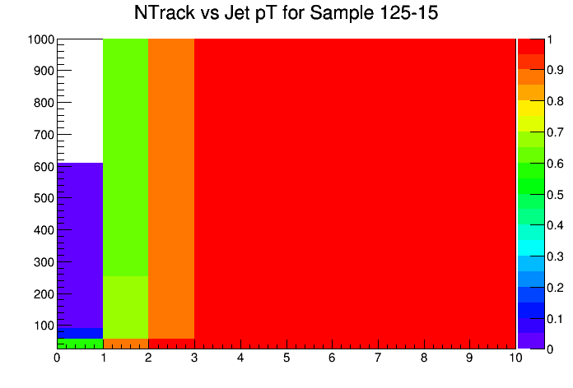
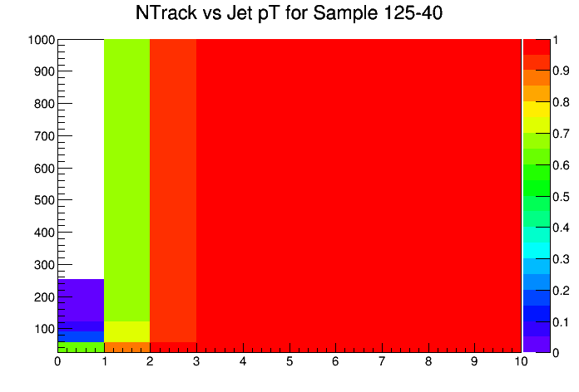
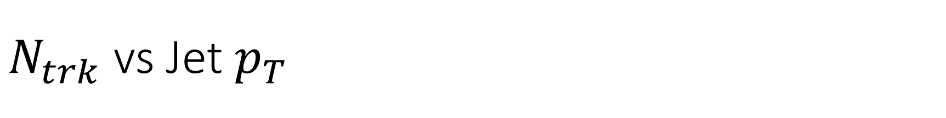
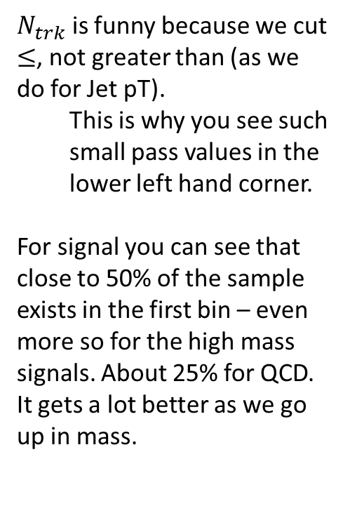
$N_{trk}$ vs Jet $p_{T}$
$N_{trk}$ is funny because we cut $≤$, not greater than (as we do for Jet pT).
This is why you see such small pass values in the lower left hand corner.
For signal you can see that close to 50% of the sample exists in the first bin – even more so for the high mass signals. About 25% for QCD. It gets a lot better as we go up in mass.

Slide 5
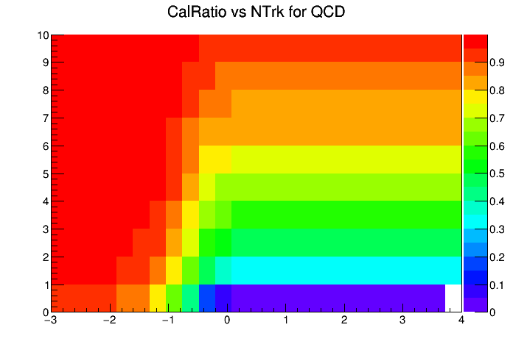
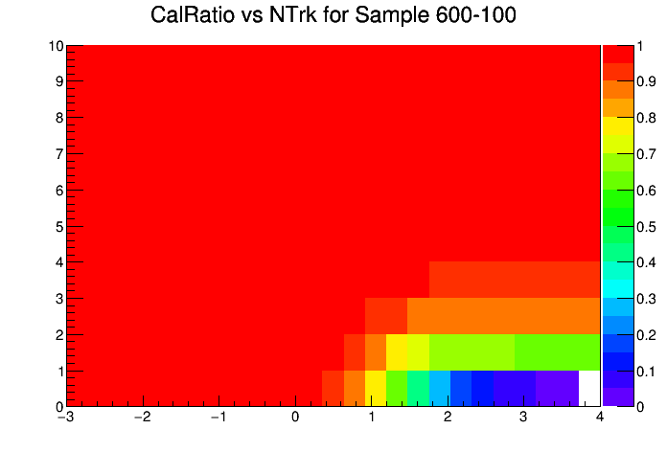
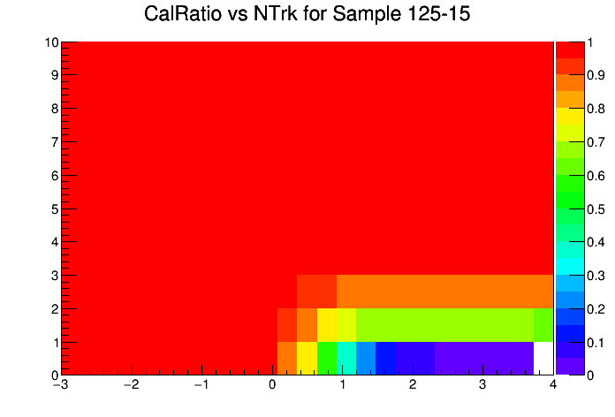
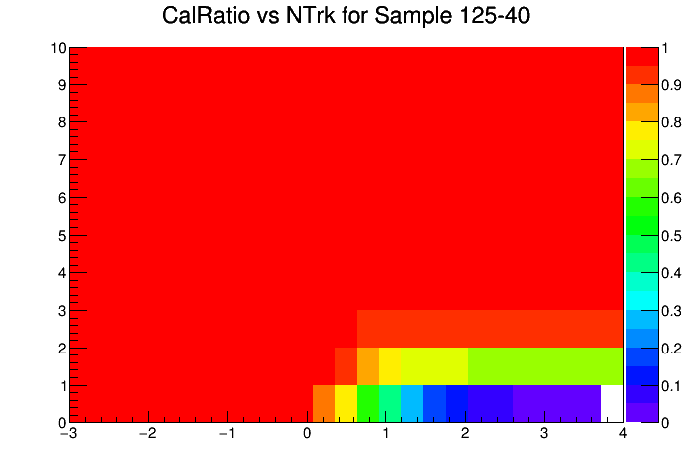

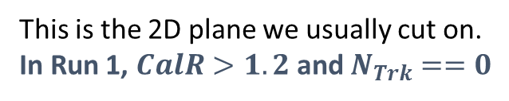
CalR vs $N_{trk}$
This is the 2D plane we usually cut on.
In Run 1, $CalR>1.2$ and $N_{Trk}==0$

